Slide 1


Aggregation and Composition

Slide 2


Slide 3


Slide 4
Problem Scenario
In Real World Scenarios, when objects communicate with each other. There could be two modes of the communications.
Notes:
Final working of your program will look like the following. If the employee is CEO, he will get 20% increase in his salary and the updated salary will be shown on the screen.
All other employees will get 10% increase in their salary.

Slide 5
Problem Scenario 01
Sometimes two objects (instances) of two different classes exists on their own and the lifetime of an object does not depend on the lifetime of another object.
Notes:
Final working of your program will look like the following. If the employee is CEO, he will get 20% increase in his salary and the updated salary will be shown on the screen.
All other employees will get 10% increase in their salary.

Slide 6
Problem Scenario 01: Example
For example, At Road, Traffic Signal and Car can be seen as two independent Classes.
Individual signals and cars can be represented through objects of these classes.
Notes:
Final working of your program will look like the following. If the employee is CEO, he will get 20% increase in his salary and the updated salary will be shown on the screen.
All other employees will get 10% increase in their salary.

Slide 7
Problem Scenario 01: Example
These instances, Car and Traffic Signal need to communicate with each other but the life time of both instances can be different from each other.
Notes:
Final working of your program will look like the following. If the employee is CEO, he will get 20% increase in his salary and the updated salary will be shown on the screen.
All other employees will get 10% increase in their salary.

Slide 8
Problem Scenario 01: Example
Existence of Car object does not depend on the existence of Traffic Signal object and Vice versa.
Notes:
Final working of your program will look like the following. If the employee is CEO, he will get 20% increase in his salary and the updated salary will be shown on the screen.
All other employees will get 10% increase in their salary.

Slide 9
Problem Scenario 02
Similarly, sometimes in real life there are some objects those existence depends on the existence of other objects.
Notes:
Final working of your program will look like the following. If the employee is CEO, he will get 20% increase in his salary and the updated salary will be shown on the screen.
All other employees will get 10% increase in their salary.

Slide 10
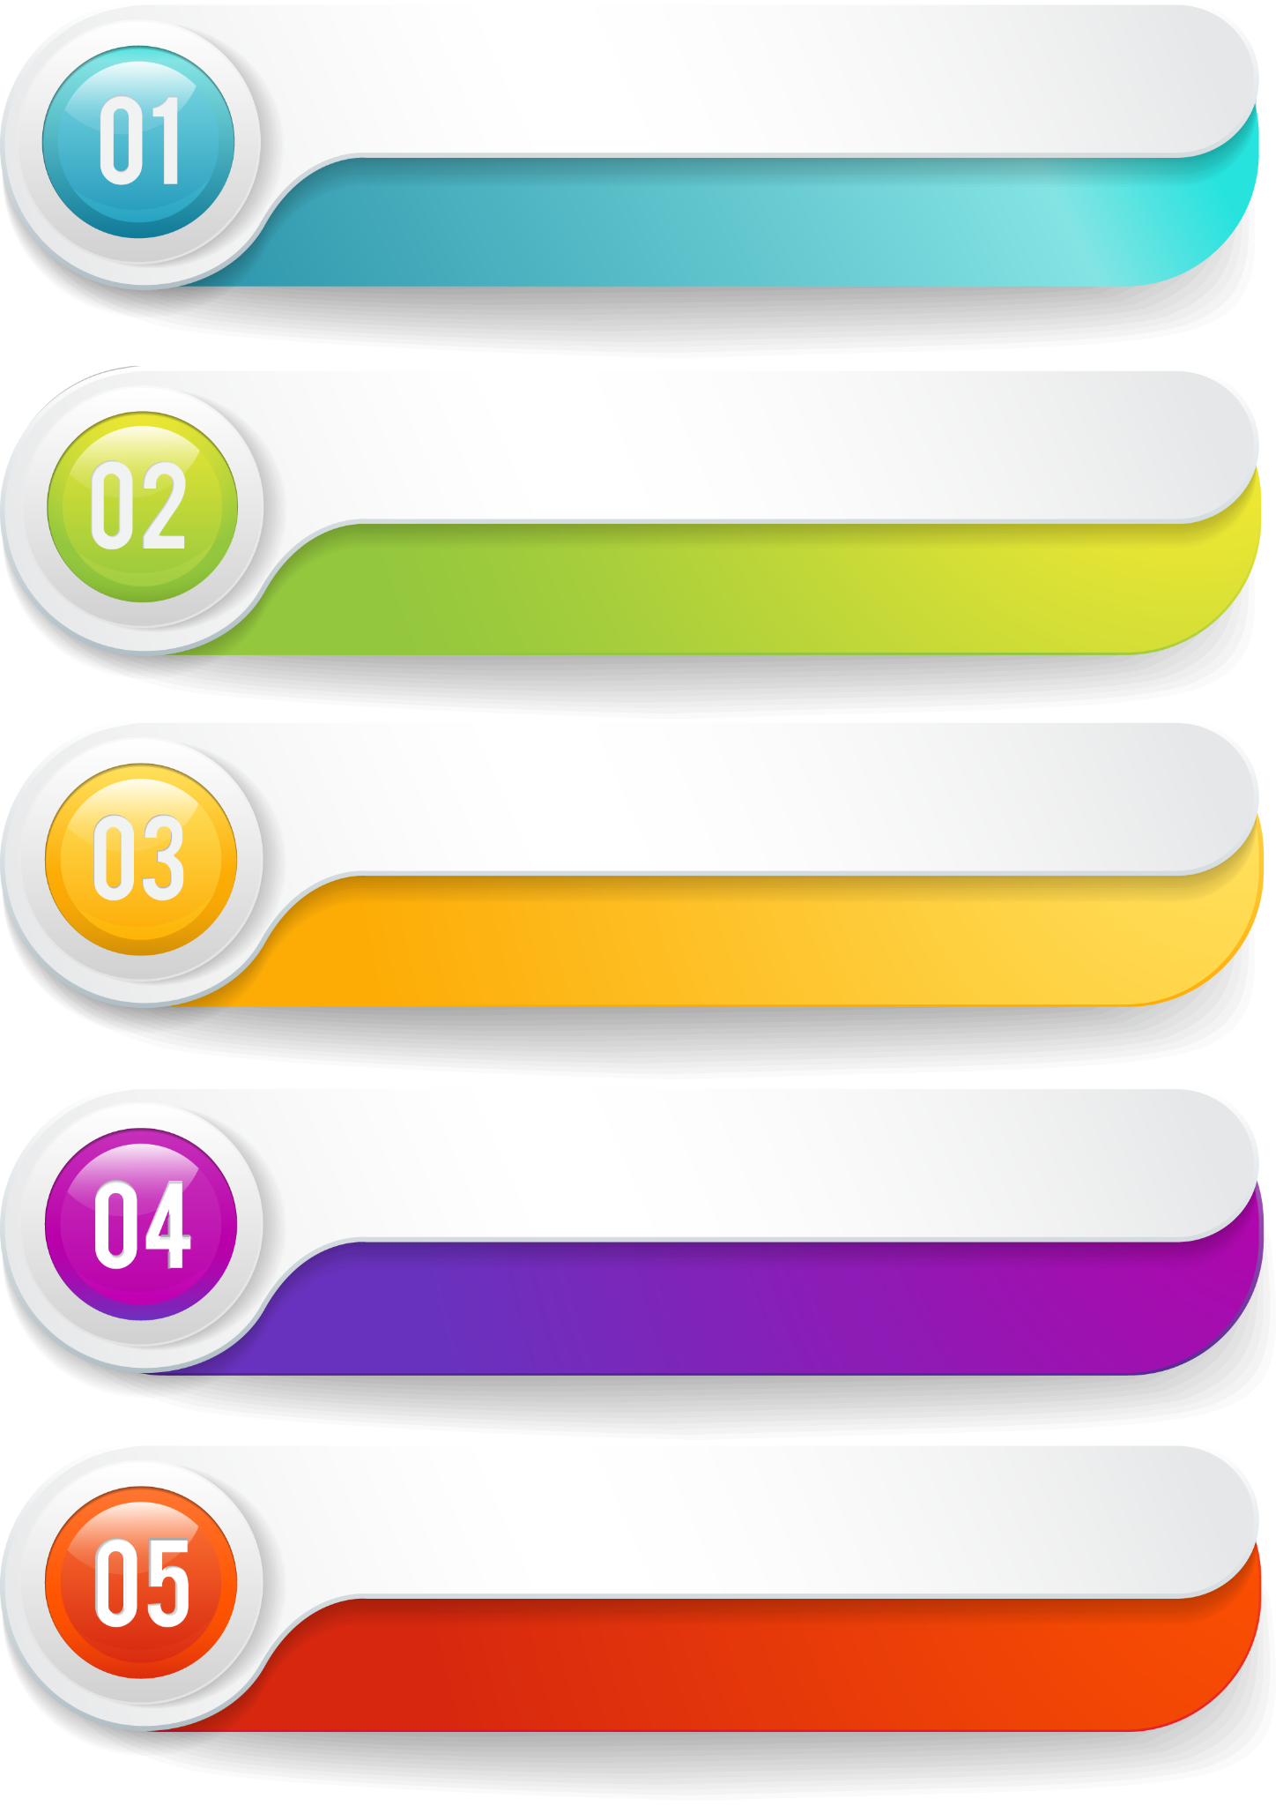

Problem Scenario 02: Example
For example, TableofContents and Book both have two different properties and qualified as for two different classes.
Notes:
Final working of your program will look like the following. If the employee is CEO, he will get 20% increase in his salary and the updated salary will be shown on the screen.
All other employees will get 10% increase in their salary.

Slide 11
Problem Scenario 02: Example
An object of TableofContents class does not mean anything without its corresponding object of Book class.
Notes:
Final working of your program will look like the following. If the employee is CEO, he will get 20% increase in his salary and the updated salary will be shown on the screen.
All other employees will get 10% increase in their salary.

Slide 12
Problem Scenario 02: Example
In other words, we can say the object lifetime of TableofContents class depends on the lifetime of the corresponding Book class
Notes:
Final working of your program will look like the following. If the employee is CEO, he will get 20% increase in his salary and the updated salary will be shown on the screen.
All other employees will get 10% increase in their salary.

Slide 13
Problem Scenario
So when the classes collaborate with each other, there could be two possible scenarios
Lifetime of objects is independent of each other.
Lifetime of objects dependent on each other.
Notes:
Final working of your program will look like the following. If the employee is CEO, he will get 20% increase in his salary and the updated salary will be shown on the screen.
All other employees will get 10% increase in their salary.

Slide 14
Types of Association
To handle these scenarios of Real Life, Object Oriented Programming offers two types of Associations.
Aggregation.
Composition.
Notes:
Final working of your program will look like the following. If the employee is CEO, he will get 20% increase in his salary and the updated salary will be shown on the screen.
All other employees will get 10% increase in their salary.

Slide 15
Types of Association: Aggregation
When two objects have independent lifetime but one object has an other object such type of association is called the Aggregation.
Association
Aggregation
Notes:
Final working of your program will look like the following. If the employee is CEO, he will get 20% increase in his salary and the updated salary will be shown on the screen.
All other employees will get 10% increase in their salary.

Slide 16
Types of Association: Aggregation
The relation between Car and Traffic Signal class is Aggregation relation because both object have their own lifetime and signal object contains the cars.
Association
Aggregation
Notes:
Final working of your program will look like the following. If the employee is CEO, he will get 20% increase in his salary and the updated salary will be shown on the screen.
All other employees will get 10% increase in their salary.

Slide 17
Aggregation: Working Example
The Car class provide one method that allow external world to communicate with it
class Car
{
public string carName; //Data Member
public Car(string name) //Parameterized Constructor
{
carName = name;
}
public void onSignalChange(string action) //Member Function/Behaviour
{
Console.WriteLine("I am " + carName + " and I am in " + action + " state");
}
}
Notes:
Final working of your program will look like the following. If the employee is CEO, he will get 20% increase in his salary and the updated salary will be shown on the screen.
All other employees will get 10% increase in their salary.

Slide 18
Aggregation: Working Example
The TrafficSignal class contains cars in carList that are present on the signal and new cars can be added into the list using addCar Function
class TrafficSignal
{
//Data Members
string state;
List<Car> carList = new List<Car>();
//Member Functions/Behaviours
public void addCar(Car c)
{
carList.Add(c);
}
}
Notes:
Final working of your program will look like the following. If the employee is CEO, he will get 20% increase in his salary and the updated salary will be shown on the screen.
All other employees will get 10% increase in their salary.

Slide 19
Aggregation: Working Example
class TrafficSignal
{
//Data Members
string state;
List<Car> carList = new List<Car>();
//Member Functions/Behaviours
public void addCar(Car c)
{
carList.Add(c);
}
public void setRedState()
{
state = "Red";
informCars();
}
public void setGreenState()
{
state = "Green";
informCars();
}
}
TrafficSignal class also provides two methods to set it state Red and Green
Notes:
Final working of your program will look like the following. If the employee is CEO, he will get 20% increase in his salary and the updated salary will be shown on the screen.
All other employees will get 10% increase in their salary.

Slide 20
Aggregation:
class TrafficSignal
{
//Data Members
string state;
List<Car> carList = new List<Car>();
//Member Functions/Behaviours
public void addCar(Car c)
{
carList.Add(c);
}
public void setRedState()
{
state = "Red";
informCars();
}
public void setGreenState()
{
state = "Green";
informCars();
}
public void informCars()
{
foreach (Car car in carList)
{
car.onSignalChange(state);
}
}
}
Both of these methods, call informCars function to update the cars state.
Notes:
Final working of your program will look like the following. If the employee is CEO, he will get 20% increase in his salary and the updated salary will be shown on the screen.
All other employees will get 10% increase in their salary.

Slide 21
Aggregation:
class TrafficSignal
{
//Data Members
string state;
List<Car> carList = new List<Car>();
//Member Functions/Behaviours
public void addCar(Car c)
{
carList.Add(c);
}
public void setRedState()
{
state = "Red";
informCars();
}
public void setGreenState()
{
state = "Green";
informCars();
}
public void informCars()
{
foreach (Car car in carList)
{
car.onSignalChange(state);
}
}
}
Both of these methods, call informCars function to update the cars state. This function inform all cars through the available method of car that the signal has been changed.
Notes:
Final working of your program will look like the following. If the employee is CEO, he will get 20% increase in his salary and the updated salary will be shown on the screen.
All other employees will get 10% increase in their salary.

Slide 22
class TrafficSignal
{
//Data Members
string state;
List<Car> carList = new List<Car>();
//Member Functions/Behaviours
public void addCar(Car c)
{
carList.Add(c);
}
}
class TrafficSignal
{
//Data Members
string state;
List<Car> carList = new List<Car>();
//Member Functions/Behaviours
public void addCar(Car c)
{
carList.Add(c);
}
public void setRedState()
{
state = "Red";
informCars();
}
public void setGreenState()
{
state = "Green";
informCars();
}
public void informCars()
{
foreach (Car car in carList)
{
car.onSignalChange(state);
}
}
}
static void Main(string[] args)
{
TrafficSignal signal1 = new TrafficSignal();
Car car1 = new Car("Car1");
Car car2 = new Car("Car2");
signal1.addCar(car1);
signal1.addCar(car2);
signal1.setRedState();
signal1.setGreenState();
Console.ReadKey();
}
Notes:
Final working of your program will look like the following. If the employee is CEO, he will get 20% increase in his salary and the updated salary will be shown on the screen.
All other employees will get 10% increase in their salary.

Slide 23
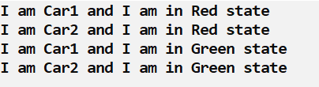
class TrafficSignal
{
//Data Members
string state;
List<Car> carList = new List<Car>();
//Member Functions/Behaviours
public void addCar(Car c)
{
carList.Add(c);
}
}
class TrafficSignal
{
//Data Members
string state;
List<Car> carList = new List<Car>();
//Member Functions/Behaviours
public void addCar(Car c)
{
carList.Add(c);
}
public void setRedState()
{
state = "Red";
informCars();
}
public void setGreenState()
{
state = "Green";
informCars();
}
public void informCars()
{
foreach (Car car in carList)
{
car.onSignalChange(state);
}
}
}
static void Main(string[] args)
{
TrafficSignal signal1 = new TrafficSignal();
Car car1 = new Car("Car1");
Car car2 = new Car("Car2");
signal1.addCar(car1);
signal1.addCar(car2);
signal1.setRedState();
signal1.setGreenState();
Console.ReadKey();
}
Notes:
Final working of your program will look like the following. If the employee is CEO, he will get 20% increase in his salary and the updated salary will be shown on the screen.
All other employees will get 10% increase in their salary.

Slide 24
Aggregation: Class Diagram
We use empty diamond symbol in class diagram to represent the Aggregation Relation between two classes.
TrafficSignal
state cars
setRedState() setGreenState() addCar(car:Car) informCar(action)
Car
Name Category Price
onSignalChange(action)
Controls
1
∞
Notes:
Final working of your program will look like the following. If the employee is CEO, he will get 20% increase in his salary and the updated salary will be shown on the screen.
All other employees will get 10% increase in their salary.

Slide 25
Types of Association
To handle these scenarios of Real Life, Object Oriented Programming offers two types of Associations.
Aggregation.
Composition.
Notes:
Final working of your program will look like the following. If the employee is CEO, he will get 20% increase in his salary and the updated salary will be shown on the screen.
All other employees will get 10% increase in their salary.

Slide 26
Types of Association: Composition
When life time of an object depends on the lifetime of another object this type of Association is called Composition.
Association
Aggregation
Composition
Notes:
Final working of your program will look like the following. If the employee is CEO, he will get 20% increase in his salary and the updated salary will be shown on the screen.
All other employees will get 10% increase in their salary.

Slide 27
Types of Association: Composition
The Association between Book and TableofContents is type of composition.
Association
Aggregation
Composition
Notes:
Final working of your program will look like the following. If the employee is CEO, he will get 20% increase in his salary and the updated salary will be shown on the screen.
All other employees will get 10% increase in their salary.

Slide 28
Composition: Working Example
The Association between Book and TableofContents is type of composition.
Association
Aggregation
Composition
Notes:
Final working of your program will look like the following. If the employee is CEO, he will get 20% increase in his salary and the updated salary will be shown on the screen.
All other employees will get 10% increase in their salary.

Slide 29
Composition: Working Example
static void Main(string[] args)
{
Book book1 = new Book();
Console.ReadKey();
}
class Book
{
public Book()
{
toc = new TableofContents();
}
TableofContents toc;
List<string> sections;
List<string> chapters;
}
class TableofContents
{
List<string> items;
public void addItem(string item)
{
items.Add(item);
}
}
Notes:
Final working of your program will look like the following. If the employee is CEO, he will get 20% increase in his salary and the updated salary will be shown on the screen.
All other employees will get 10% increase in their salary.

Slide 30
Composition: Working Example
We use filled diamond symbol in class diagram to represent the Composition Relation between two classes.
Book
sections chapters
Book()
TableOfContents
items
Print addItem(item)
1
Controls
1
Notes:
Final working of your program will look like the following. If the employee is CEO, he will get 20% increase in his salary and the updated salary will be shown on the screen.
All other employees will get 10% increase in their salary.

Slide 31


Conclusion
Association has two types
1) Aggregation
2) Composition
When life times of two separate objects are independent of each other, this type of association is called Aggregation
When life time of two separate objects are dependent of each other, this type of association is called Composition.

Slide 32

Learning Objective
Identify and Write Code for Aggregation and Composition Scenarios.
Notes:
After this video you will be able to Write a Conditional Statement with Single Boolean Expression consisting of an Equal Comparison Operator.

Slide 33

Self Assessment: Association
1. A Football player has a football. Write two classes.
1. Football
2. FootballPlayer
Football class has type, size and weight attributes. Write the default constructor as well as parameterized constructor of the class.
FootballPlayer has name and Football attributes.
Write the default as well as parameterized constructor of the class.

Slide 34
Self Assessment: Association
2. Write the code in C# for the following domain model.
Book
name: String author: Author price: float quantity: int
Book() Book(name, author, price, quantity)
Author
name: String email: String gender: Char
Author() Author(name, email, gender)
Writes
1
1

